Slide 1


Relearn plastics tpm & LTTA
26th of june – 1st of july 2022
Host:

Slide 2

Project
Project title: Innovative learning methodologies in schools for strengthening the awareness and active citizenship about plastics consumption
Project start date: 1st of November 2020
Project end date: 30th of April 2023
Main objective of the project: INNOVATION
NEW GRANT AGREEMENT!

Slide 3
objectives
… the improvement of key competences students by means of art, creativity and new learning methodologies with the purpose of strengthening the awareness and active citizenship about plastics consumption.
To achieve this general goal, the following specific goals have been defined:
- Supporting opportunities for students in acquiring and developing key competences, including basic skills through art-based learning and Service Learning Methodology .
- Strengthening the profile of the teaching professions, developing innovative methodologies to increase the awareness and action in students about plastics.

Slide 4
activities
1) Beginning – Agreements, preparation of activities and organization.
2) School staff training – Preparation of a technical manuals and training course of school teachers
3) School student training – Implementation of methodologies in classrooms and experiences and learning exchange for school students.
4) Closure – Final evaluation road map for future joint ventures.
5) Project Management (transversal) – Tri-monthly reports, virtual and transnational meetings.
6) Dissemination (transversal) –Website, social networks, meetings, mainly addressed school students and teachers and professionals.

Slide 5
1 – intelectual outputs
IO1- Learning Material: Plastics in Europe – UM FOV Slovenia - COMPLETED
IO2- Learning Guide: “Plastic Awareness through Art-methodologies” – Youth club Serbia - COMPLETED
IO3 – Service Learning Methodology: “Active citizen for plastics reduction” – CRESOL Spain - COMPLETED
IO4 – Guide and practical tools. Implementation “Plastic Awareness” in classroom – E-gimnazija Serbia (+TPM 3)
IO5 – Guide: Best practices of implementation Service-Learning for Active Citizens plastic challenges – IES CID Spain (+TPM 4)

Slide 6
2 – LTTA 1 & Ltta 2
LLTA1- C1- Short-term joint staff training events for teachers in Spain:
Training in Plastic Challenges, Art-learning Methodologies and Service-Learning Methodology.
LLTA2 - C2 Short-term exchanges of groups of pupils for students in Slovenia:
Exchange event with Aware and Active Students in Plastics Challenges

Slide 7
3 – MULTIPLIER EVENTS
8 MULTIPLIER EVENTS
UM FOV Slovenia
Associació Cultural CRESOL - Art i Creativitat per un desenvolupament social, sostenible i solidari Spain - COMPLETED
IES CID CAMPEADOR Spain
CSI CENTER FOR SOCIAL INNOVATION LTD Cyprus
P.G.M.S. (PRIVATE GRAMMAR & MODERNSCHOOLS) LIMITED Cyprus
Youth Club of municipality of Stara Pazova Serbia
E gimnazija Serbia
Biotehniski center Naklo Slovenia

Slide 8
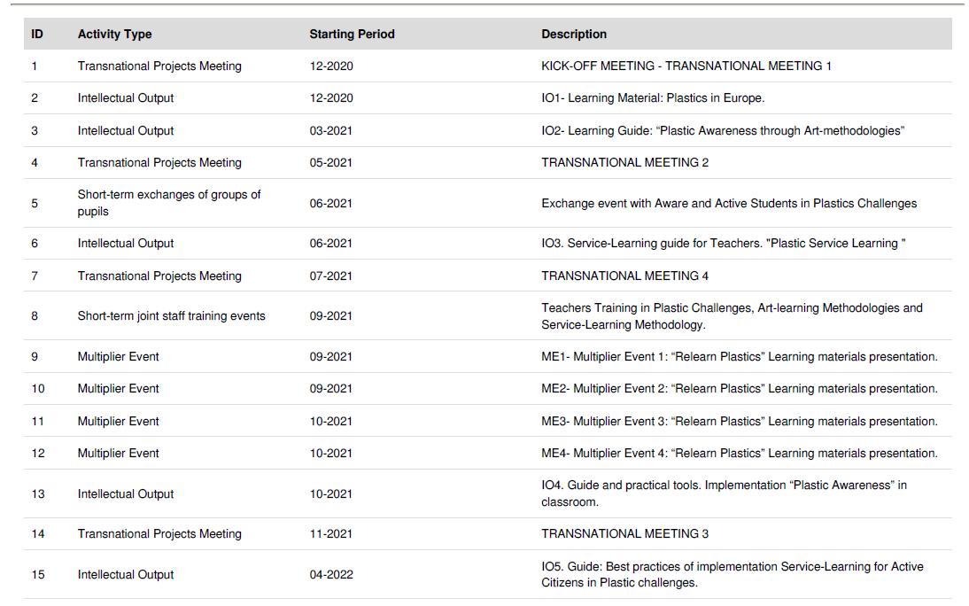

Slide 9
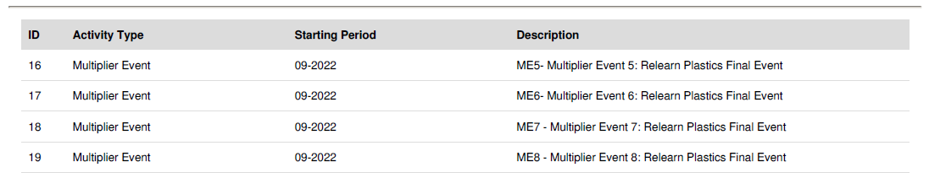

Slide 10
Going forward
ACTIVITY | WHERE? | WHEN?
TRANSNATIONAL MEETING 3 | SERBIA | END OF NOVEMBER 2022 (DATES: 24TH – 25TH OF NOVEMBER 2022)
TRANSNATIONAL MEETING 4 | CYPRUS | MARCH 2023 (30TH – 31ST MARCH 2023)

Slide 11
Going forward
ACTIVITY | WHERE? | WHEN?
MULTIPLIER EVENT 1 | CRESOL SPAIN | FINISHED
MULTIPLIER EVENT 2 | UM FOV | MARCH 2023
MULTIPLIER EVENT 3 | IES CID CAMPEADOR SPAIN | SEPTEMBER 2022
MULTIPLIER EVENT 4 | CSI CYPRUS | SEPTEMBER 2022
MULTIPLIER EVENT 5 | PGMS CYPRUS | APRIL 2023
MULTIPLIER EVENT 6 | E-GIMNAZIJA SERIBA | OCTOBER 2022
MULTIPLIER EVENT 7 | YOUTH CLUB SERBIA | OCTOBER 2022
MULTIPLIER EVENT 8 | BC NAKLO SLOVENIA | MARCH 2023

Slide 12
Going forward
ACTIVITY | WHERE? | WHEN?
INTELECTUAL OUTPUT 4 | E-gimnazija | NOVEMBER 2022 (JULY – NOVEMBER)
INTELECTUAL OUTPUT 5 | IES CID | MARCH 2023 (NOVEMBER – MARCH)

Slide 13
Going forward
ACTIVITY | WHERE? | WHEN?
LTTA 2 | SLOVENIA | BEGINNING OF MARCH 2023 (6TH – 10TH OF MARCH 2023)

Slide 14
STAFF TRAINING – LTTA 1
SCHOOLS – POSSIBLE PRESENTATION – EXCHANGE OF IDEAS, PRACTICES …

Slide 15
STUDENTS TRAINING
SCHOOLS – POSSIBLE PRESENTATIONS – EXCHANGE OF IDEAS, PRACTICES …

Slide 16
TRANSLATIONS
Translations for IO´s and other documents:
SLOVENIAN
SPANISH
GREEK
SERBIAN

Slide 17
Next days, wishes …

Slide 18

Work for today – ltta 1
Teachers day

Slide 19
Work for today – preparing for io 4
The objective of this IO4 is focused on students. The aim is for students can increase their awareness of plastics challenges and at the same time increase key competencies using art-based learning activities.
TWO GROUPS:
UM PREPARES PPT (MAX 5 SLIDES) FOR IO 1 & OKOSP PREPARES PPT (MAX 5 SLIDES) FOR IO 2 – Where is the focus – teachers perspective? – IF NEEDED☺
PRESENTATION OF TEACHERS – WHAT HAS BEEN DONE TILL NOW?
HOW TO PREPARE IO4?

Slide 20
How to prepare io 4?
1st PART - METHODOLOGY
First, the output will contain a description about how to prepare the students in the classroom. How to involve and motivate the students and what the expected results of this preparation are.
EACH SCHOOL WILL PREPARE A SHORT DESCRIPTION (1/2 A PAGE).

Slide 21
How to prepare io 4?
2nd PART – TOOLS OF IMPLEMENTATION
It will describe the tools for implementation. With these tools teachers will increase the awareness of students about plastics challenges. Some of the specific ideas for the tools are:
• Exercises to use plastics as an art element and create and find artistic works with plastics.
• Short guide for using drama to show and represent plastics challenges.
• Story telling as tool for talk about plastics challenges.
• Short guide to create a performance to show and represent plastic challenges.
Each Secondary School will be in charge of developing two tools to work with the students, so finally the IO will be created by 8 tools.
What has been done till now😊

Slide 22
How to prepare io 4?
3rd PART – EXAMPLES OF IMPLEMENTATION & ASSESSMENT
This part will give some examples for future implementation.
The examples will be based in the completion of the experiences in the 4 school centers. It will contain description, pictures and evaluation opinions from teachers and students.
FOR TODAY: Also during the LTTA teacher will discuss about what kind of tools are the best options and they will decide what exactly to do and how to share the tasks.

Slide 23

IO 4 – Deadline: November 2022

Slide 24
What‘s the IO 5
The objective of this output is the creation of a guide with best practices about the implementation of Service-Learning Methodology in Plastic Challenges.
CRESOL prepares PPT for IO 3 (if needed) (max 5 slides) – what has to be extra explained?
After the LTTA1 all the teachers will implement the new knowledge in their own schools, in a classroom of at least 25 students.

Slide 25
HOW TO PREPARE IO 5
The Guide will be composed of four best practices with 3 clearly differentiated blocks per experience:
1- Project Description: It will describe the First Stage of the process. Explaining:
a. The project needs and the service implemented.
b. How the process of needs validation with schools, local entities and public institutions has been.
c. How the participatory process of the service definition has been.

Slide 26
HOW TO PREPARE IO 5
2- Service Implementation: This module will describe in detail the action carried out by the participants. It will include pictures and comments by participants.
3- Results and conclusions. This module will contain an analysis of the implementation, describing the main results and conclusions.
Some quantitative indicator will be collected and testimonials will explain their experience as qualitative indicators as well.

Slide 27
How to prepare io 5
The creation of this IO will start to be planned in the LTTA1, where teachers will adapt all the new knowledge from a pedagogical point of view. So they will be able to organize and manage the implementation of a Service with students.

Slide 28
IO5 – deadline: march 2023

Slide 29

LTTA 2 - BRAINSTORMING

Slide 30
Exchange event with Aware and Active Students in Plastics Challenges.
1st DAY
Team Building activities and Teaching Sessions.
Some games and activities for team building will be done to improve the communication among the participants and to create a good ambiance.
Some teaching sessions will be done by experts and teachers about three topics.
1. Plastics Impact.
2. Plastics Challenges.
3. Plastics Awareness and Active Citizenship through innovative education.

Slide 31
Exchange event with Aware and Active Students in Plastics Challenges.
2nd DAY
Presentations of activities implemented in schools and Discussions. First Session of working together.
The students will present the projects done in their schools. Later teachers will promote and motivate a discussion among the participants.
During the afternoon the first session of working together will start.
4 groups of students with 2 participants from each country (8 participants per group) will be created and they will start to work on a new project or idea.

Slide 32
Exchange event with Aware and Active Students in Plastics Challenges.
3rd DAY
Creativity and Art-Based techniques. Second Session of working together.
Some Creative techniques and Art-based activities will be implemented with the students in order to motivate and create new ideas for the projects. It also will be very participative to connect and increase the relationships among the students.
Second Session to work in groups with the new ideas.

Slide 33
Exchange event with Aware and Active Students in Plastics Challenges.
4th DAY
New conclusions about the Working Together Sessions. Social challenges and needs related with plastics. Social Service as tools to solve the problems.
Conclusions about the working sessions will be shown and discussed.
Some field visits will be done to discover some samples of real projects.

Slide 34
Exchange event with Aware and Active Students in Plastics Challenges.
5th DAY
Conclusions of students project and exchange event.
Some teacher will talk to the students about the competencies they have learnt in the project, the conclusions of the event, and the experience.
After the conclusions of the teacher, students will have a session to give some opinions and tell their experiences.

Slide 35
When – FEBRUARY 2023

Slide 36

video

Slide 37
VIDEO – Suggestion – at ltta2?
The video will present the project, show its results, and inspire the viewers for further action.
The video will be done by students to increase the impact in the schools. All 4 schools will participate recording some activities during the project and testimonials. The video presents the project, shows its results, and inspires the viewers for further action. Impact will be reached by
(1) testimonial (student with disadvantaged background, teacher, possible employer),
(2) showing the usage of IO materials in schools
(3) LLTA´s events
(4) opening new questions, indicating further actions that could be done in the field, signalling future collaboration pathways.
Leader: IES Cid Campeador
Contribution: All Schools (including participating students)

Slide 38
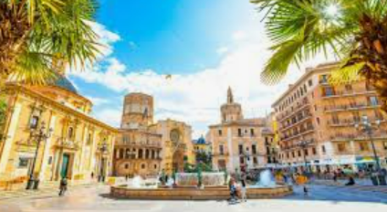
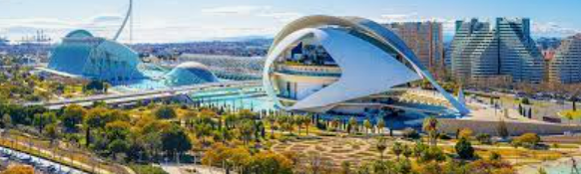
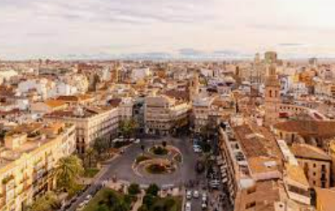
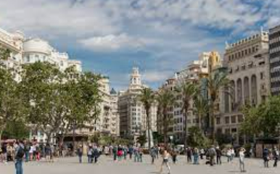
CONCLUSION

